Slide 1
Chapter 12: Mass-Storage Systems

Slide 2
Chapter 12: Mass-Storage Systems
Overview of Mass Storage Structure
Disk Structure
Disk Attachment
Disk Scheduling
Disk Management
Swap-Space Management
RAID Structure
Disk Attachment
Stable-Storage Implementation

Slide 3
Objectives
Describe the physical structure of secondary and tertiary storage devices and the resulting effects on the uses of the devices
Explain the performance characteristics of mass-storage devices
Discuss operating-system services provided for mass storage, including RAID and HSM

Slide 4
Overview of Mass Storage Structure
Magnetic disks provide bulk of secondary storage of modern computers
Drives rotate at 60 to 200 times per second
Transfer rate is rate at which data flow between drive and computer
Positioning time (random-access time) is time to move disk arm to desired cylinder (seek time) and time for desired sector to rotate under the disk head (rotational latency)
Head crash results from disk head making contact with the disk surface
That’s bad
Disks can be removable
Drive attached to computer via I/O bus
Buses vary, including EIDE, ATA, SATA, USB, Fiber Channel, SCSI
Host controller in computer uses bus to talk to disk controller built into drive or storage array

Slide 5

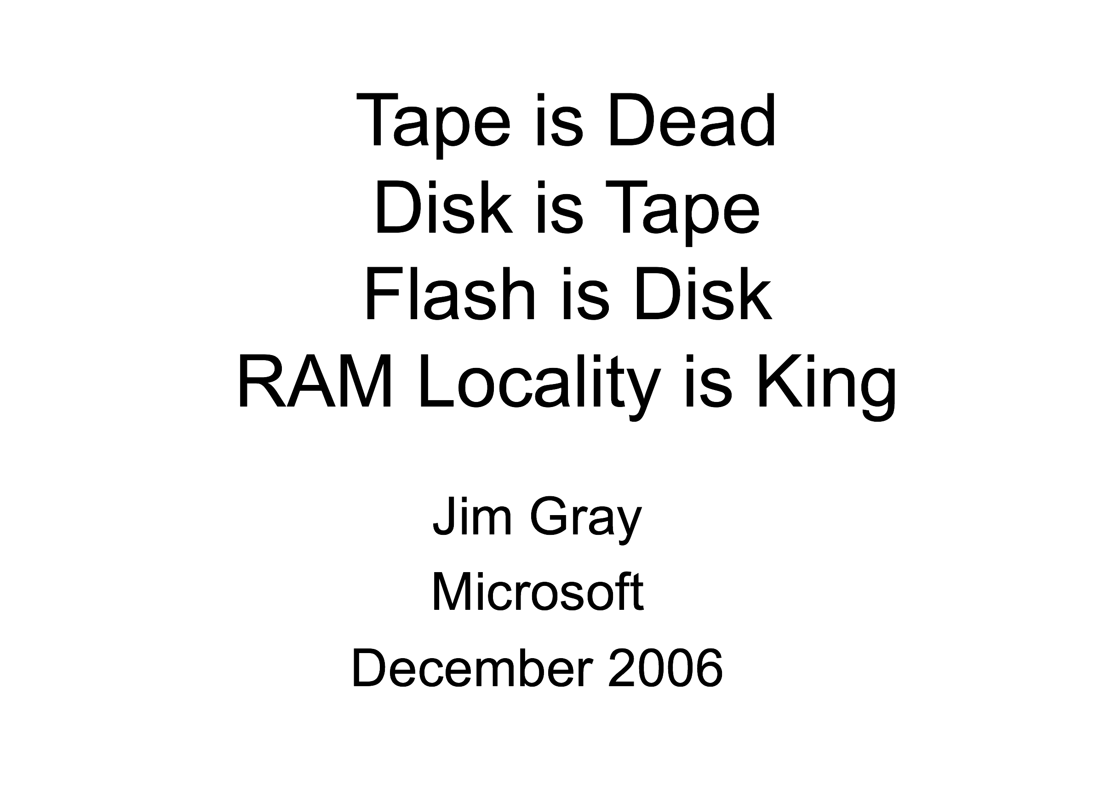
The Man Who Disappeared in 2007
Turing Award Laureate

Slide 6
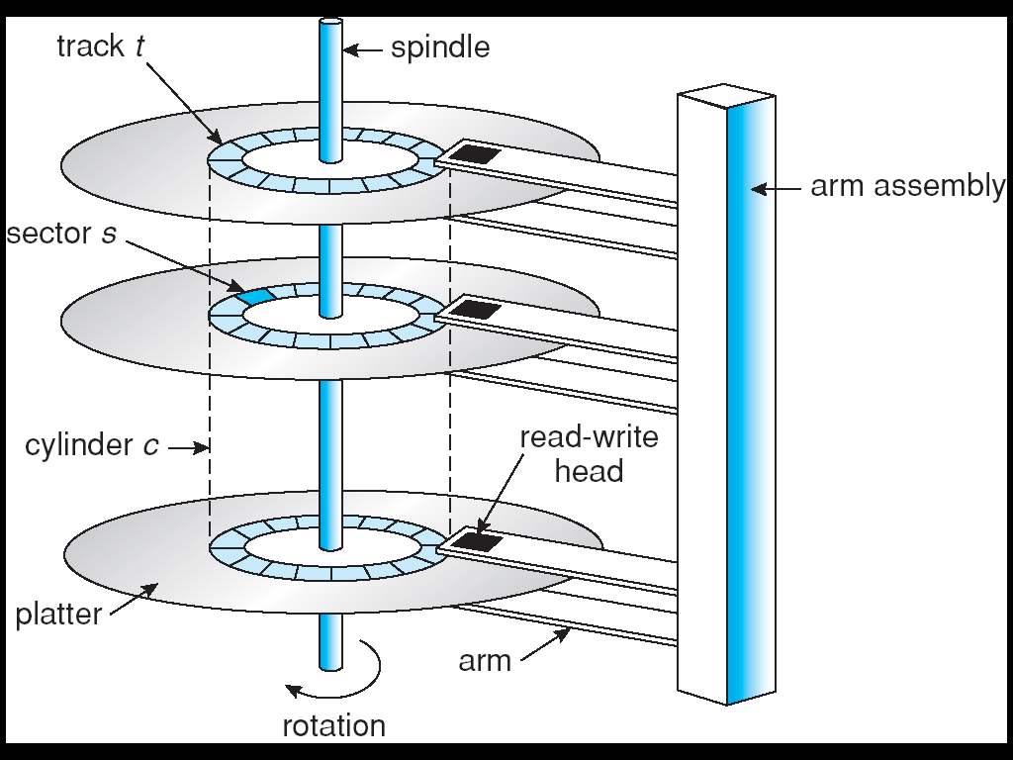
Moving-head Disk Machanism

Slide 7
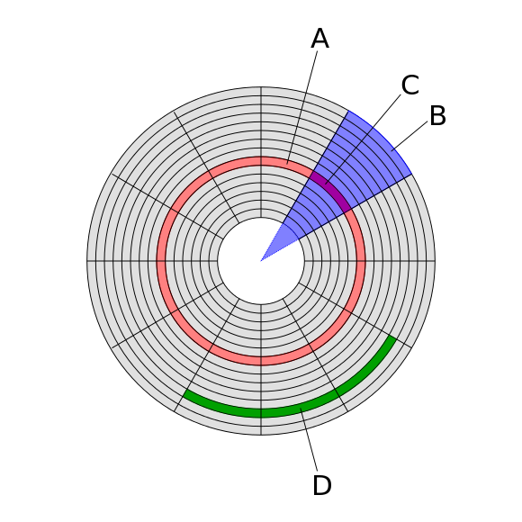
Disk Sector
Disk structures:
Track (磁道)
Geometrical sector
Track sector (扇区)
Cluster (簇)
Each sector stores a fixed amount of user-accessible data, traditionally 512 bytes for hard disk drives (HDDs) and 2048 bytes for CD-ROMs and DVD-ROMs. Newer HDDs use 4096-byte (4 KiB) sectors, which are known as the Advanced Format (AF).
Notes:
如果转速为R圈/sec, 则Avg Rotation delay= 1/(2R);
一个磁盘块的传输时间为磁头扫过扇区所花的时间，如果每个sector有k个扇区，则传输时间= 1/(Rk)

Slide 8
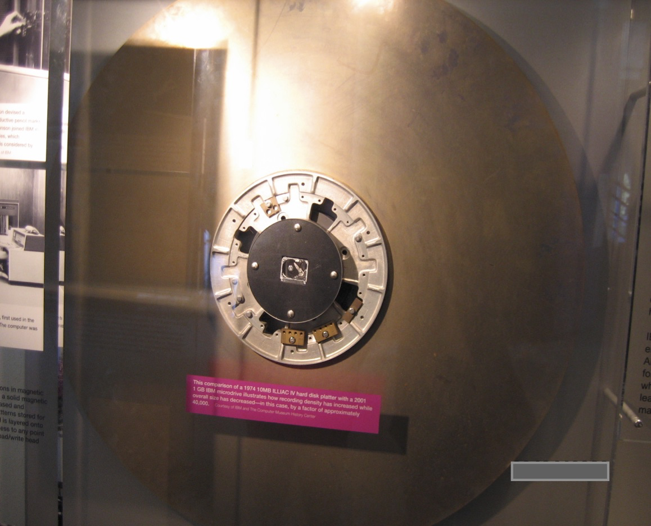

Slide 9
Nonvolatile Memory Devices
SSD uses NVM devices
Data cannot be overwritten— rather, the NAND cells have to be erased first. An erasure is much slower than a read (the fastest operation) or a write (slower than read)
Maximum ~100,000 program-erase cycles

Slide 10
Overview of Mass Storage Structure (Cont.)
Magnetic tape
Was early secondary-storage medium
Relatively permanent and holds large quantities of data
Access time slow
Random access ~1000 times slower than disk
Mainly used for backup, storage of infrequently-used data, transfer medium between systems
Kept in spool and wound or rewound past read-write head
Once data under head, transfer rates comparable to disk
20-200GB typical storage
Common technologies are 4mm, 8mm, 19mm, LTO-2 and SDLT

Slide 11
Disk Structure
Disk drives are addressed as large 1-dimensional arrays of logical blocks, where the logical block is the smallest unit of transfer.
The 1-dimensional array of logical blocks is mapped into the sectors of the disk sequentially.
Sector 0 is the first sector of the first track on the outermost cylinder.
Mapping proceeds in order through that track, then the rest of the tracks in that cylinder, and then through the rest of the cylinders from outermost to innermost.

Slide 12
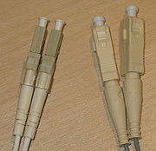
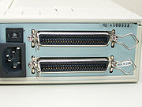
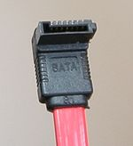
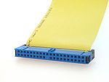
Disk Attachment
SCSI
Fibre Channel
ATA(IDE)
Serial ATA

Slide 13
Disk Attachment
Host-attached storage accessed through I/O ports talking to I/O buses
SCSI itself is a bus, up to 16 devices on one cable, SCSI initiator requests operation and SCSI targets perform tasks
Each target can have up to 8 logical units (disks attached to device controller
Fibre Channel (FC) is high-speed serial architecture
Can be switched fabric with 24-bit address space – the basis of storage area networks (SANs) in which many hosts attach to many storage units
Can be arbitrated loop (FC-AL) of 126 devices

Slide 14
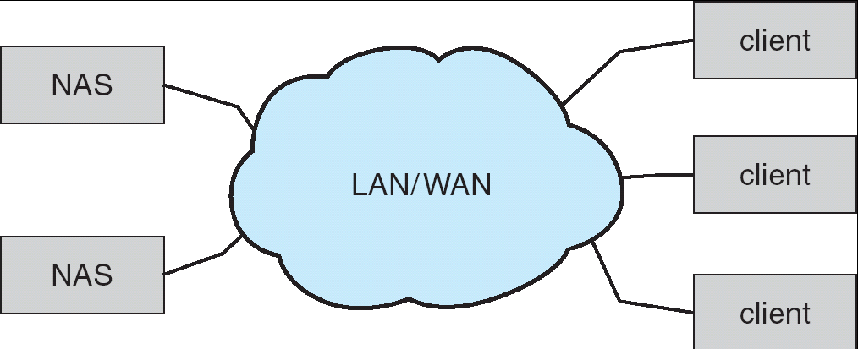
Network-Attached Storage
Network-attached storage (NAS) is storage made available over a network rather than over a local connection (such as a bus)
NFS and CIFS are common protocols
Implemented via remote procedure calls (RPCs) between host and storage
New iSCSI protocol uses IP network to carry the SCSI protocol
Problem: storage I/O consumes bandwidth on the network.

Slide 15
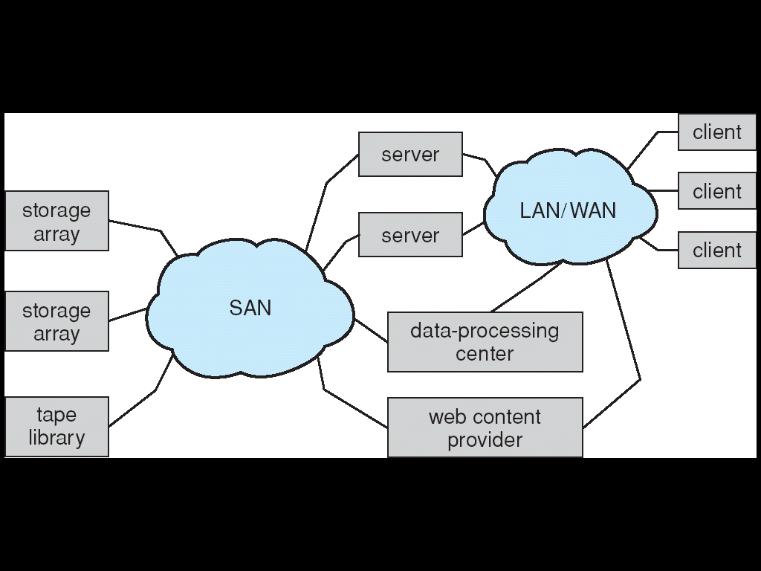
Storage Area Network
Common in large storage environments (and becoming more common)
Multiple hosts attached to multiple storage arrays - flexible

Slide 16
Accessing a Disk Page
Time to access (read/write) a disk block:
seek time (moving arms to position disk head on track)
rotational delay (waiting for block to rotate under head)
transfer time (actually moving data to/from disk surface)
Seek time and rotational delay dominate.
Seek time varies from about 1 to 20msec
Rotational delay varies from 0 to 10msec
Transfer rate is about 1msec per 4KB page
Key to lower I/O cost: reduce seek/rotation delays! Hardware vs. software solutions?
Notes:
22

Slide 17
Disk Scheduling
The operating system is responsible for using hardware efficiently — for the disk drives, this means having a fast access time and disk bandwidth.
Access time has two major components
Seek time is the time for the disk are to move the heads to the cylinder containing the desired sector.
Rotational latency is the additional time waiting for the disk to rotate the desired sector to the disk head.
Minimize seek time
Metric: Seek time ≈ seek distance
Disk bandwidth is the total number of bytes transferred, divided by the total time between the first request for service and the completion of the last transfer.

Slide 18
Disk Scheduling (Cont.)
Several algorithms exist to schedule the servicing of disk I/O requests.
We illustrate them with a request queue (0-199).
98, 183, 37, 122, 14, 124, 65, 67
Current head pointer 53

Slide 19
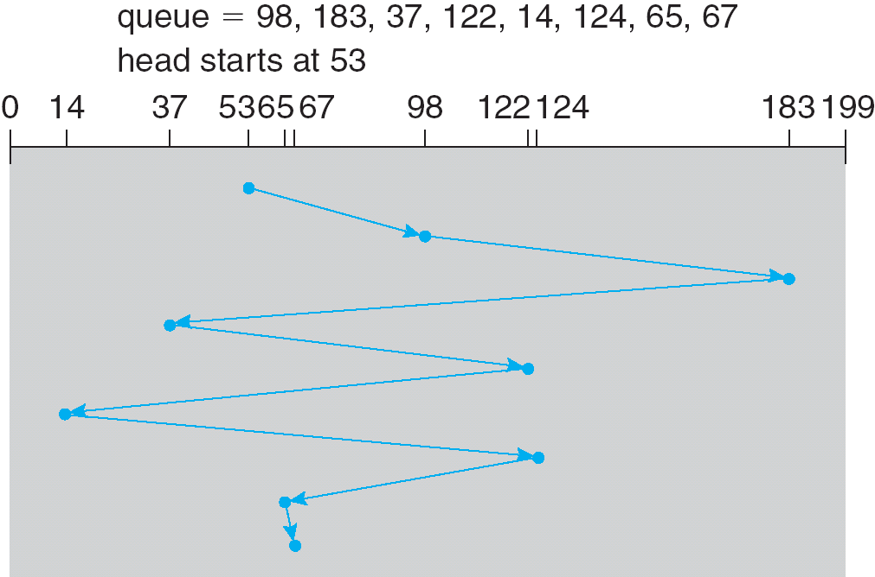
FCFS
Illustration shows total head movement of 640 cylinders.

Slide 20
Shortest-seek-time-first (SSTF)
Selects the request with the minimum seek time from the current head position.
SSTF scheduling is a form of SJF scheduling; may cause starvation of some requests.
Illustration shows total head movement of 236 cylinders.

Slide 21
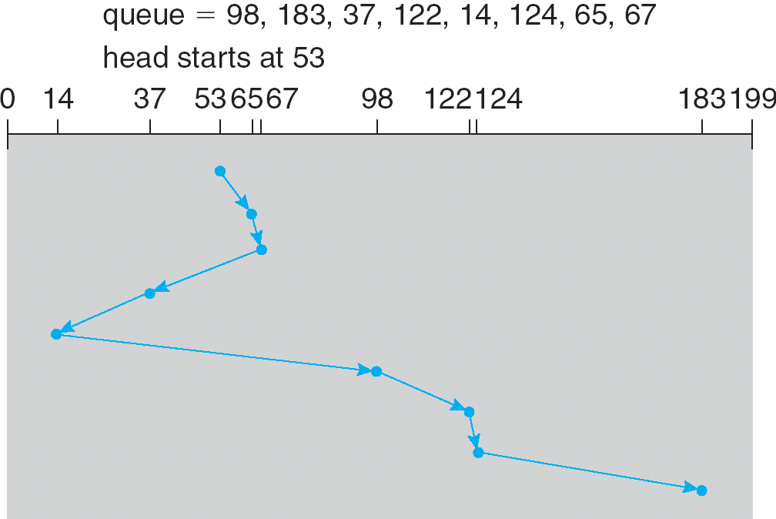
SSTF (Cont.)

Slide 22
SCAN
The disk arm starts at one end of the disk, and moves toward the other end, servicing requests until it gets to the other end of the disk, where the head movement is reversed and servicing continues.
Sometimes called the elevator algorithm.

Slide 23
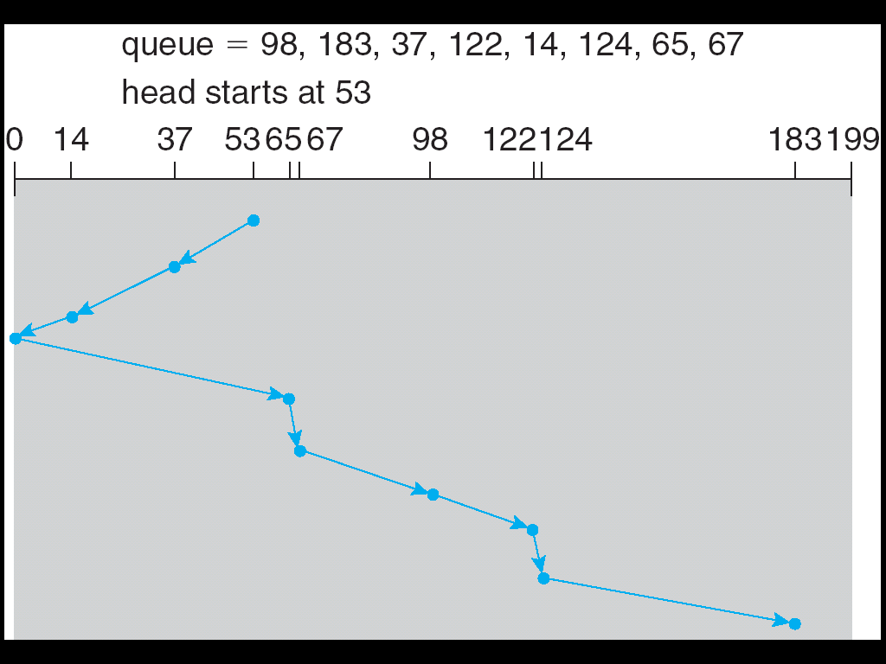
SCAN (Cont.)
LOOK
LOOK needs total head movement of 208 cylinders.

Slide 24
C-SCAN
Provides a more uniform wait time than SCAN.
The head moves from one end of the disk to the other. servicing requests as it goes. When it reaches the other end, however, it immediately returns to the beginning of the disk, without servicing any requests on the return trip.
Treats the cylinders as a circular list that wraps around from the last cylinder to the first one.

Slide 25
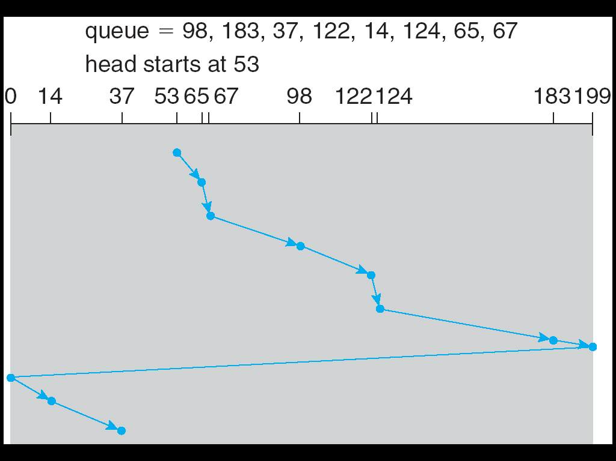
C-SCAN (Cont.)

Slide 26
C-LOOK
Version of C-SCAN
Arm only goes as far as the last request in each direction, then reverses direction immediately, without first going all the way to the end of the disk.

Slide 27
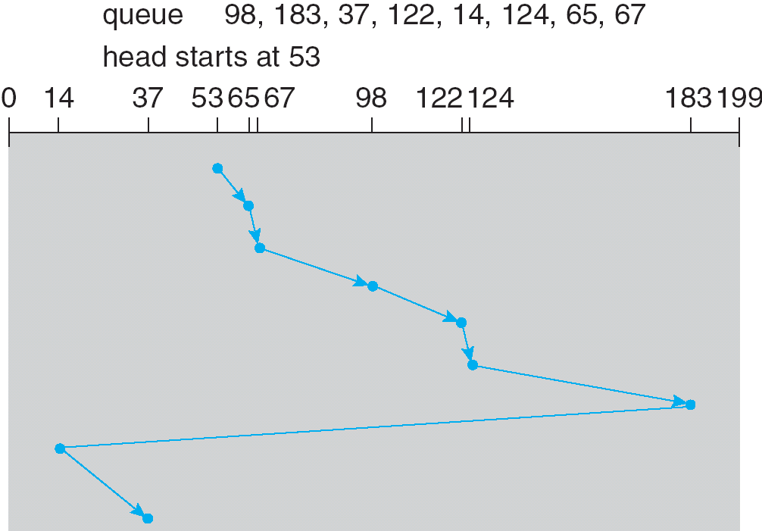
C-LOOK (Cont.)

Slide 28
Selecting a Disk-Scheduling Algorithm
SSTF is common and has a natural appeal
SCAN and C-SCAN perform better for systems that place a heavy load on the disk.
Performance depends on the number and types of requests.
Requests for disk service can be influenced by the file-allocation method.
The disk-scheduling algorithm should be written as a separate module of the operating system, allowing it to be replaced with a different algorithm if necessary.
Either SSTF or LOOK is a reasonable choice for the default algorithm.

Slide 29
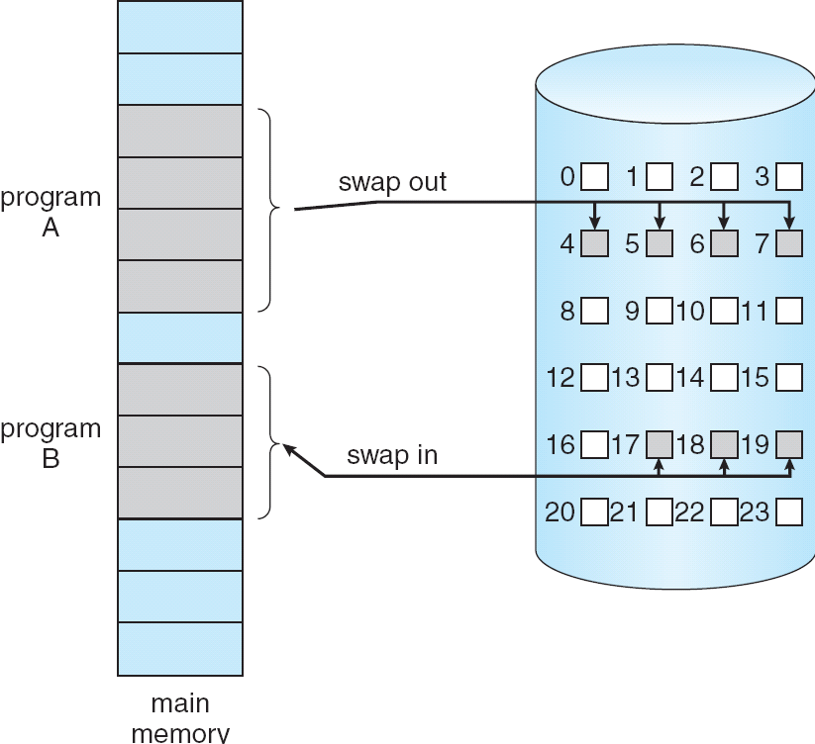
Swapping re-examined: Why Swap-out to Contiguous Disk Blocks?
Remember that we swap out process memory pages onto hard disk while swap in those demanded by paging.

Slide 30
Disk Management
Low-level formatting, or physical formatting — Dividing a disk into sectors that the disk controller can read and write.
To use a disk to hold files, the operating system still needs to record its own data structures on the disk.
Partition the disk into one or more groups of cylinders.
Logical formatting or “making a file system”.
Boot block initializes system.
The bootstrap is stored in ROM.
Bootstrap loader program.
Methods such as sector sparing used to handle bad blocks.

Slide 31
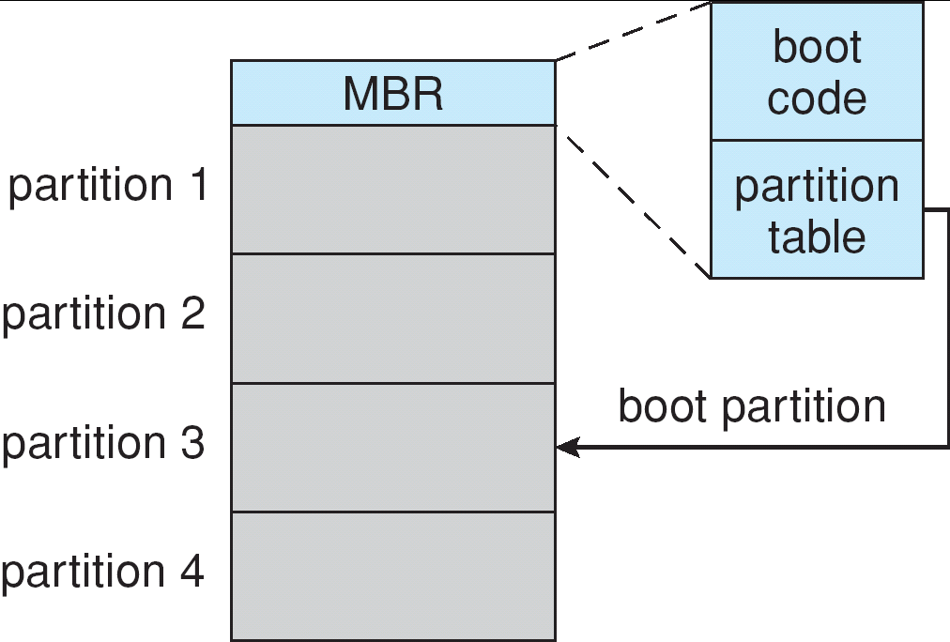
Booting from a Disk in Windows

Slide 32
Swap-Space Management
Swap-space — Virtual memory uses disk space as an extension of main memory.
Swap-space can be carved out of the normal file system,or, more commonly, it can be in a separate disk partition.
Swap-space management
4.3BSD allocates swap space when process starts; holds text segment (the program) and data segment.
Kernel uses swap maps to track swap-space use.
Solaris 2 allocates swap space only when a page is forced out of physical memory, not when the virtual memory page is first created.

Slide 33
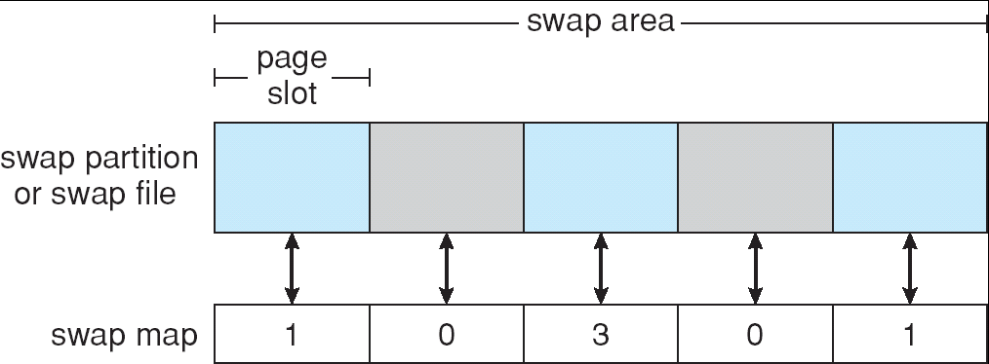
Data Structures for Swapping on Linux Systems
4KB
This swapped page is mapped to three
processes

Slide 34
RAID Structure
Redundant Arrays of Independent Disks
RAID – multiple disk drives provides reliability via redundancy.
RAID is arranged into six different levels.

Slide 35
RAID (cont)
Several improvements in disk-use techniques involve the use of multiple disks working cooperatively.
Disk striping uses a group of disks as one storage unit.
Bit-level Striping
Block-level Striping – different blocks of a file are striped
RAID schemes improve performance and improve the reliability of the storage system by storing redundant data.
Mirroring or shadowing keeps duplicate of each disk.
Block interleaved parity uses much less redundancy.

Slide 36
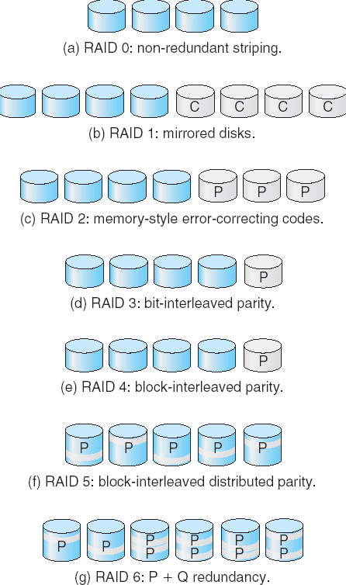
RAID Levels

Slide 37
RAID 1: Provides fault tolerance from disk errors and failure of all but one of the drives. Increased read performance occurs when using a multi-threaded operating system that supports split seeks, very small performance reduction when writing. Array continues to operate so long as at least one drive is functioning.
RAID 2: memory-style Hamming code parity. Not really practical.
RAID 3: The single parity disk is a bottleneck for writing since every write requires updating the parity data.
RAID 4: Identical with RAID 3 except using block level parity. The parity disk can become a bottleneck. Large (parallel) reads and writes are good. Small write causes 4 page accesses. (read data/parity and write them back.)
RAID 5: Distributed parity requires all drives but one to be present to operate; drive failure requires replacement, but the array is not destroyed by a single drive failure.
RAID 6: extra redundancy information to guard two disk failures.

Slide 38
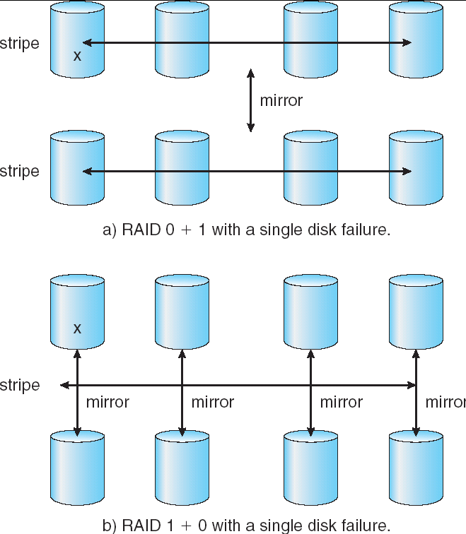
RAID (0 + 1) and (1 + 0)
Stripe and then mirror
Mirror and then stripe

Slide 39
Stable-Storage Implementation
Write-ahead log scheme requires stable storage.
To implement stable storage:
Replicate information on more than one nonvolatile storage media with independent failure modes.
Update information in a controlled manner to ensure that we can recover the stable data after any failure during data transfer or recovery.

Slide 40
Tertiary Storage Devices
Low cost is the defining characteristic of tertiary storage.
Generally, tertiary storage is built using removable media
Common examples of removable media are floppy disks and CD-ROMs; other types are available.

Slide 41
Removable Disks
Floppy disk — thin flexible disk coated with magnetic material, enclosed in a protective plastic case.
Most floppies hold about 1 MB; similar technology is used for removable disks that hold more than 1 GB.
Removable magnetic disks can be nearly as fast as hard disks, but they are at a greater risk of damage from exposure.

Slide 42
Removable Disks (Cont.)
A magneto-optic disk records data on a rigid platter coated with magnetic material.
Laser heat is used to amplify a large, weak magnetic field to record a bit.
Laser light is also used to read data (Kerr effect).
The magneto-optic head flies much farther from the disk surface than a magnetic disk head, and the magnetic material is covered with a protective layer of plastic or glass; resistant to head crashes.
Optical disks do not use magnetism; they employ special materials that are altered by laser light.

Slide 43
WORM Disks
The data on read-write disks can be modified over and over.
WORM (“Write Once, Read Many Times”) disks can be written only once.
Thin aluminum film sandwiched between two glass or plastic platters.
To write a bit, the drive uses a laser light to burn a small hole through the aluminum; information can be destroyed but not altered.
Very durable and reliable.
Read Only disks, such ad CD-ROM and DVD, come from the factory with the data pre-recorded.

Slide 44
Tapes
Compared to a disk, a tape is less expensive and holds more data, but random access is much slower.
Tape is an economical medium for purposes that do not require fast random access, e.g., backup copies of disk data, holding huge volumes of data.
Large tape installations typically use robotic tape changers that move tapes between tape drives and storage slots in a tape library.
stacker – library that holds a few tapes
silo – library that holds thousands of tapes
A disk-resident file can be archived to tape for low cost storage; the computer can stage it back into disk storage for active use.

Slide 45
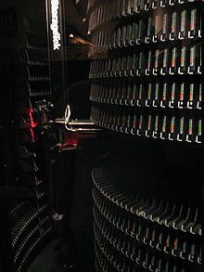
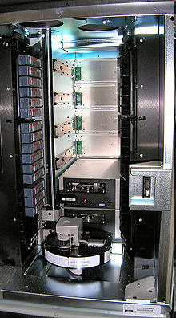
Tape Library

Slide 46
Operating System Issues
Major OS jobs are to manage physical devices and to present a virtual machine abstraction to applications
For hard disks, the OS provides two abstraction:
Raw device – an array of data blocks.
File system – the OS queues and schedules the interleaved requests from several applications.

Slide 47
Application Interface
Most OSs handle removable disks almost exactly like fixed disks — a new cartridge is formatted and an empty file system is generated on the disk.
Tapes are presented as a raw storage medium, i.e., and application does not open a file on the tape, it opens the whole tape drive as a raw device.
Usually the tape drive is reserved for the exclusive use of that application.
Since the OS does not provide file system services, the application must decide how to use the array of blocks.
Since every application makes up its own rules for how to organize a tape, a tape full of data can generally only be used by the program that created it.

Slide 48
Tape Drives
The basic operations for a tape drive differ from those of a disk drive.
locate positions the tape to a specific logical block, not an entire track (corresponds to seek).
The read position operation returns the logical block number where the tape head is.
The space operation enables relative motion.
Tape drives are “append-only” devices; updating a block in the middle of the tape also effectively erases everything beyond that block.
An EOT mark is placed after a block that is written.

Slide 49
File Naming
The issue of naming files on removable media is especially difficult when we want to write data on a removable cartridge on one computer, and then use the cartridge in another computer.
Contemporary OSs generally leave the name space problem unsolved for removable media, and depend on applications and users to figure out how to access and interpret the data.
Some kinds of removable media (e.g., CDs) are so well standardized that all computers use them the same way.

Slide 50
Hierarchical Storage Management (HSM)
A hierarchical storage system extends the storage hierarchy beyond primary memory and secondary storage to incorporate tertiary storage — usually implemented as a jukebox of tapes or removable disks.
Usually incorporate tertiary storage by extending the file system.
Small and frequently used files remain on disk.
Large, old, inactive files are archived to the jukebox.
HSM is usually found in supercomputing centers and other large installations that have enormous volumes of data.

Slide 51
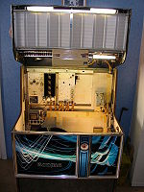
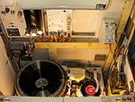
A Jukebox

Slide 52
Speed
Two aspects of speed in tertiary storage are bandwidth and latency.
Bandwidth is measured in bytes per second.
Sustained bandwidth – average data rate during a large transfer; # of bytes/transfer time. Data rate when the data stream is actually flowing.
Effective bandwidth – average over the entire I/O time, including seek or locate, and cartridge switching. Drive’s overall data rate.

Slide 53
Speed (Cont.)
Access latency – amount of time needed to locate data.
Access time for a disk – move the arm to the selected cylinder and wait for the rotational latency; < 35 milliseconds.
Access on tape requires winding the tape reels until the selected block reaches the tape head; tens or hundreds of seconds.
Generally say that random access within a tape cartridge is about a thousand times slower than random access on disk.
The low cost of tertiary storage is a result of having many cheap cartridges share a few expensive drives.
A removable library is best devoted to the storage of infrequently used data, because the library can only satisfy a relatively small number of I/O requests per hour.

Slide 54
Reliability
A fixed disk drive is likely to be more reliable than a removable disk or tape drive.
An optical cartridge is likely to be more reliable than a magnetic disk or tape.
A head crash in a fixed hard disk generally destroys the data, whereas the failure of a tape drive or optical disk drive often leaves the data cartridge unharmed.

Slide 55
Cost
Main memory is much more expensive than disk storage
The cost per megabyte of hard disk storage is competitive with magnetic tape if only one tape is used per drive.
The cheapest tape drives and the cheapest disk drives have had about the same storage capacity over the years.
Tertiary storage gives a cost savings only when the number of cartridges is considerably larger than the number of drives.

Slide 56
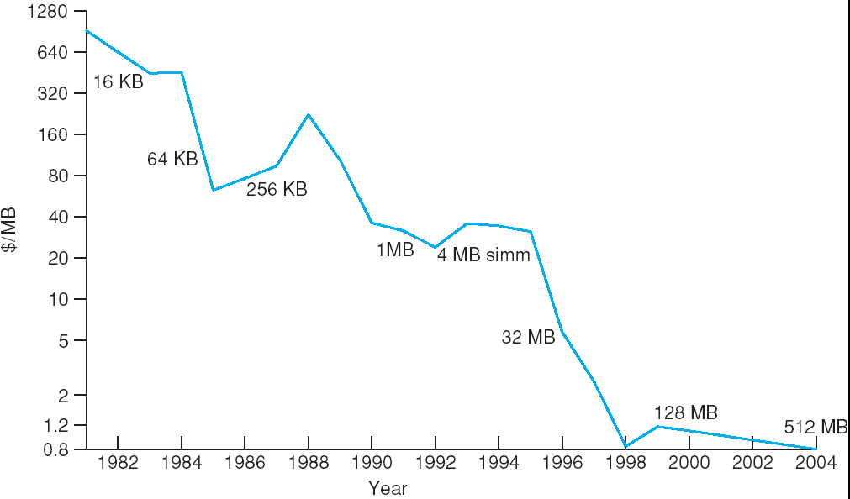
Price per Megabyte of DRAM, From 1981 to 2004

Slide 57
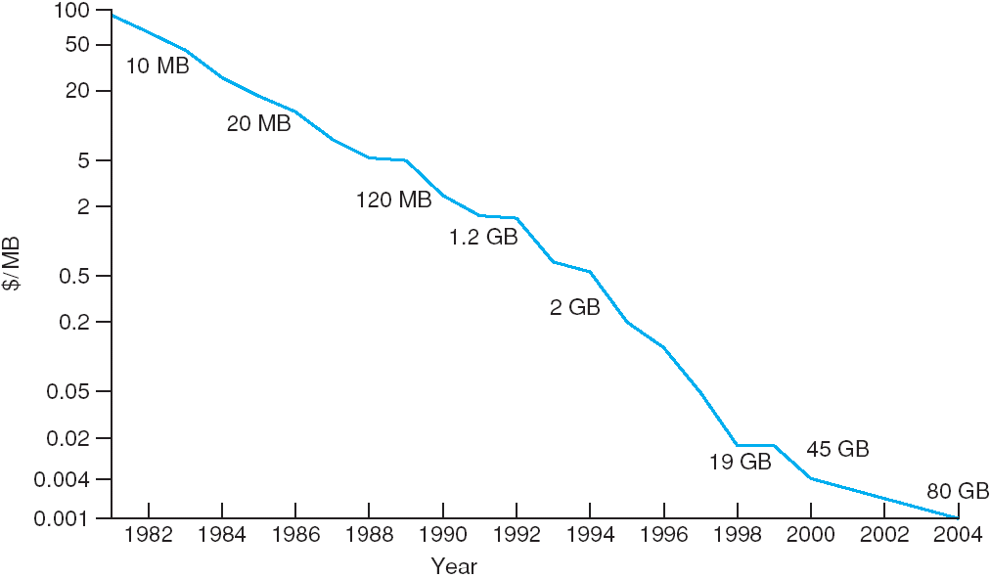
Price per Megabyte of Magnetic Hard Disk, From 1981 to 2004

Slide 58
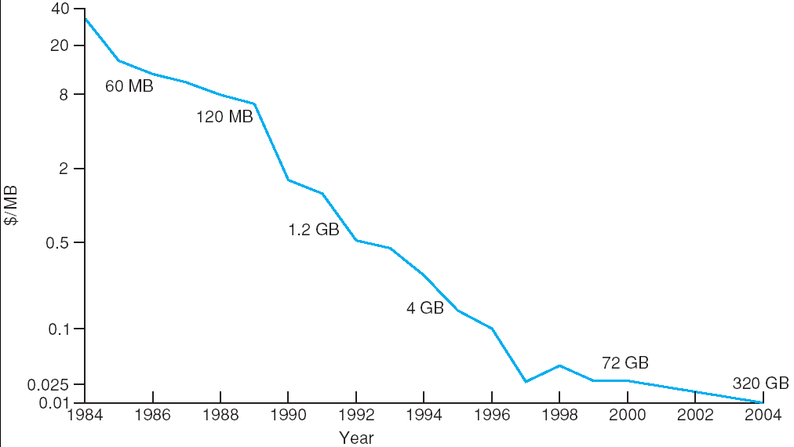
Price per Megabyte of a Tape Drive, From 1984-2000

Slide 59
Moore’s Law being proved...
As of 2017, a typical 10000 rpm desktop HDD has a sustained "disk-to-buffer" data transfer rate up to 1 Gbits/sec. 4TB/1Gb=32000 s

Slide 60
End of Chapter 12

